Slide 1
Presenter Information:
Slides 2- 24 provide a full lesson with an activity. Discussion time is approx. 30 minutes, not including the activity.
Slides 26-33 can be added to another lesson. Discussion time is approx. 10 minutes.
See notes section for discussion guidance.
Please adjust this as appropriate for your audience.
Notes:
Dear presenter:
This presentation has been given to you to help educate Indiana youth about the Lifeline Law and dangers of underage drinking.
Notes are provided to help you guide the conversation and an activity.
There is discussion about alcohol and this is not intended to promote underage drinking, it it intended to educate young adults about the dangers related to alcohol consumption.
Please adjust the slides and discussion to best educate your audience.

Slide 2


A STATEWIDE PUBLIC EDUCATION AND
AWARENESS PROGRAM
Notes:
Dear presenter:
This presentation has been given to you to help educate Indiana youth about the Lifeline Law and dangers of underage drinking.
Notes are provided to help you guide the conversation and an activity.
There is discussion about alcohol and this is not intended to promote underage drinking, it it intended to educate young adults about the dangers related to alcohol consumption.
Please adjust the slides and discussion to best educate your audience.
Make Good Decisions is an awareness campaign administered by Indiana Youth Services Association.
For questions, reach out to Michele: mwhelchel@indysb.org

Slide 3
Welcome &
Introductions
Notes:
Introductions as needed.
Next slide is agenda.

Slide 4
Agenda:
Lifeline Law explained
Portion sizes
Effects of alcohol
Brett’s Story
Recognizing & Getting help
Make the Pledge
Spread awareness
Notes:
This presentation will cover:
What the lifeline law is
What portion sizes look like
How alcohol effects us
Brett’s story (video)
How to recognize and get help in an emergency
Make a pledge and be prepared with a plan
Other ways to share this message
Adjust agenda as needed

Slide 5
Indian Lifeline Law
The Lifeline Law gives amnesty for underage drinking and many related drinking offenses to a person in need, a person who calls, and bystanders who assist in reporting a medical emergency, crime or sexual assault. The purpose of the law is not to encourage underage drinking, but to protect Hoosiers in emergency situations and hopefully save lives.
It’s simple:
            1) CALL or TEXT 911
            2) STAY
            3) COOPERATE
Notes:
Discussion:
Can someone read this?
What do you think it means?
Do you understand the word ‘amnesty’? (that means immunity, you will be protected from prosecution, or being charged with a crime such as underage drinking)
Who is a ”person in need”? (this is a person who is sick, injured, assaulted, had too much to drink, etc.. i.e. the person you would be getting help for if you called 911)
Why is this law important? (this is about harm reduction, to save lives in case kids are afraid they would get in trouble if they call for help)
Do you know who makes this kind of law? (it is from our state law-makers, Senators and Representatives; it started with SB 227 in 2012 and then SB 74 was added in 2025)
Is this something you can remember; call, stay, cooperate?
Why is it important to Stay & Cooperate? What does that mean? (this is required for amnesty; you will need to talk to first responders and police who come to help; stay calm and answer questions)
Did you know that you can text 911 for help? (voice is preferred, but texting is ok if that’s what you need to do. Indiana was one for the first states to have texting to 911- cool!)
Additional info:
The Indiana Lifeline Law was first established with the help of Senator Jim Merritt in 2012.
It did not originally include amnesty for the person in need (i.e. the person who was had too much to drink), but this was corrected in 2025 with SB 74 which added amnesty for the person in need. College students from about 6 different universities around Indiana helped to make this happen-very cool!
Some other states have similar laws, but it is not nationwide. Each state has specific guidelines. This is good to know if/when you go to college or are visiting outside of Indiana.
Some students may see the limitations. It protects them from “many related drinking offenses” but not from all crimes; yes this might seem a little unclear. Underage drinking is usually the biggest worry for those thinking about calling. Students may not have amnesty from other consequences such as getting in trouble with a sports team, club, or other school related expectations. This is where we can reiterate that we are not saying it is ok to drink underage; but we are letting them know that a friend could die if they do not seek help and they will not be charged with the crime of underage drinking.
This presentation will focus on alcohol consumption. But the law also applies to getting help if there was a crime or sexual assault.
https://www.911.gov/newsletters/issue-9/national-annual-report-reveals-ng911-text-to-911-progress/#:~:text=Thirty%2Dthree%20states%20reported%20having,states%20in%20the%20calendar%20year
http://indianalifeline.org/
Cue for next slide:
Next let’s talk about what happens when someone has alcohol.

Slide 6
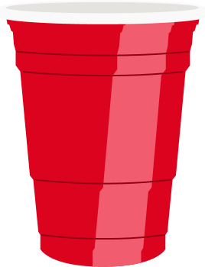
In Case of a Curious Mistake...
For Just 1 drink-
30 minutes to feel the full effects
60 minutes to process
Notes:
Discussion:
Have you heard about how alcohol can affect you? (yes- probably related to you should not drive if you have had too much to drink)
If you have one drink, it can take 30 minutes before you feel it. Then it can take at least an hour for your body to process. Do you know what one drink looks like? (it can vary! That is why it is easy to make a mistake. Beer/wine/liquor examples are on the next few slides)
Do you know how much a solo cup can hold? (about 16 oz, similar to a water bottle)
Why are we using a solo cup for this example? (common at parties)
Why do we call this a curious mistake? (again- not promoting alcohol consumption; but we realize that many of your friends may have tried alcohol before on purpose or if someone else gave it them without permission.)
Additional information:
Curiosity can easily lead to a mistake if the person does not know how alcohol affects them and has too much OR if they don’t know that alcohol was in their drink.
Some alcohol has different strengths – beer vs wine vs hard liquor
Different portions affect everyone differently. Our bodies don’t process it the same. –more discussion on upcoming slides.
Cue for next slide:
Next we will look at portions because it can be confusing.

Slide 7

Notes:
Discussion:
A Solo cup holds a little more than 1 serving of beer.
If you were at a party how would you know how full the cup should be? (you would probably just fill it to the top)
Additional:
Some beers do have different ABV (alcohol by volume) but they are usually similar. Beer with a higher ABV are served in smaller glasses.
Cue for next slide:
Can you guess how many glasses of wine fit into a solo cup?

Slide 8

Notes:
Discussion:
Did anyone guess right?
A Solo cup holds the equivalent of 3 glasses of wine.
If you were at a party how would you know how full the cup should be? (maybe you would fill it to the top)
Additional:
Some wine does have different ABV (alcohol by volume) but they are usually similar. Wine is often served by 6 oz or 9 oz.
A wine cooler is different than wine and usually contains less alcohol.
Cue for next slide:
Can you guess how many shots of hard liquor fit into a solo cup?

Slide 9

Notes:
Discussion:
Did anyone guess right?
A Solo cup holds Holds about 12 shot-glasses worth of hard liquor.
A shot glass is considered a serving size.
If you were at a party how would you know how full the cup should be?
Typically, hard liquor is mixed with other liquids, juice/soda/flavoring. This is why the alcohol taste can sometimes be hidden, and someone may not really know how much they have had.
Have you heard of different types of hard liquor/spirits? (just to check understanding, not to encourage knowledge of all the different types; vodka, rum, gin, whisky, bourbon, etc.)
Additional:
There are many different kinds of hard liquor.
They are usually described by ‘proof’, which is a measurement of alcohol related to ABV.
Cue for next slide:
Next let’s look at how alcohol can affect our bodies.

Slide 10



Blood Alcohol Content
110 lb female
.51%
150 lb female
.37%
110 lb male
.44%
150 lb male
.32%
BAC Impairment
Mild .05%
Increased .15%
Severe .30%
Life threat .45%
2 hour
Notes:
Discussion:
Blood Alcohol Content, or BAC, refers to the percentage of alcohol in a person's bloodstream, and can be measured within 30-70 minutes after drinking.
Contrary to popular belief, nothing can lower BAC except time; coffee, cold showers, and chugging glasses of water will not help you sober up any faster.
This example is of hard liquor in a standard water bottle, drank in about 2 hours
If consumed, it would take over 20 hours to return to normal.
Standford- https://vaden.stanford.edu/super/alcohol-drug-info/reduce-your-risk/what-blood-alcohol-concentration-bac
Additional:
The Science we have for this is based upon Male/Female assigned at birth (that is the way the studies have been done.)
Different apps may show Blood alcohol content
Suggested App: BAC-Calculator IU
https://alcohol.indianapolis.iu.edu/calculators/bac.html
Cue for next slide:
What do you notice about the numbers?

Slide 11
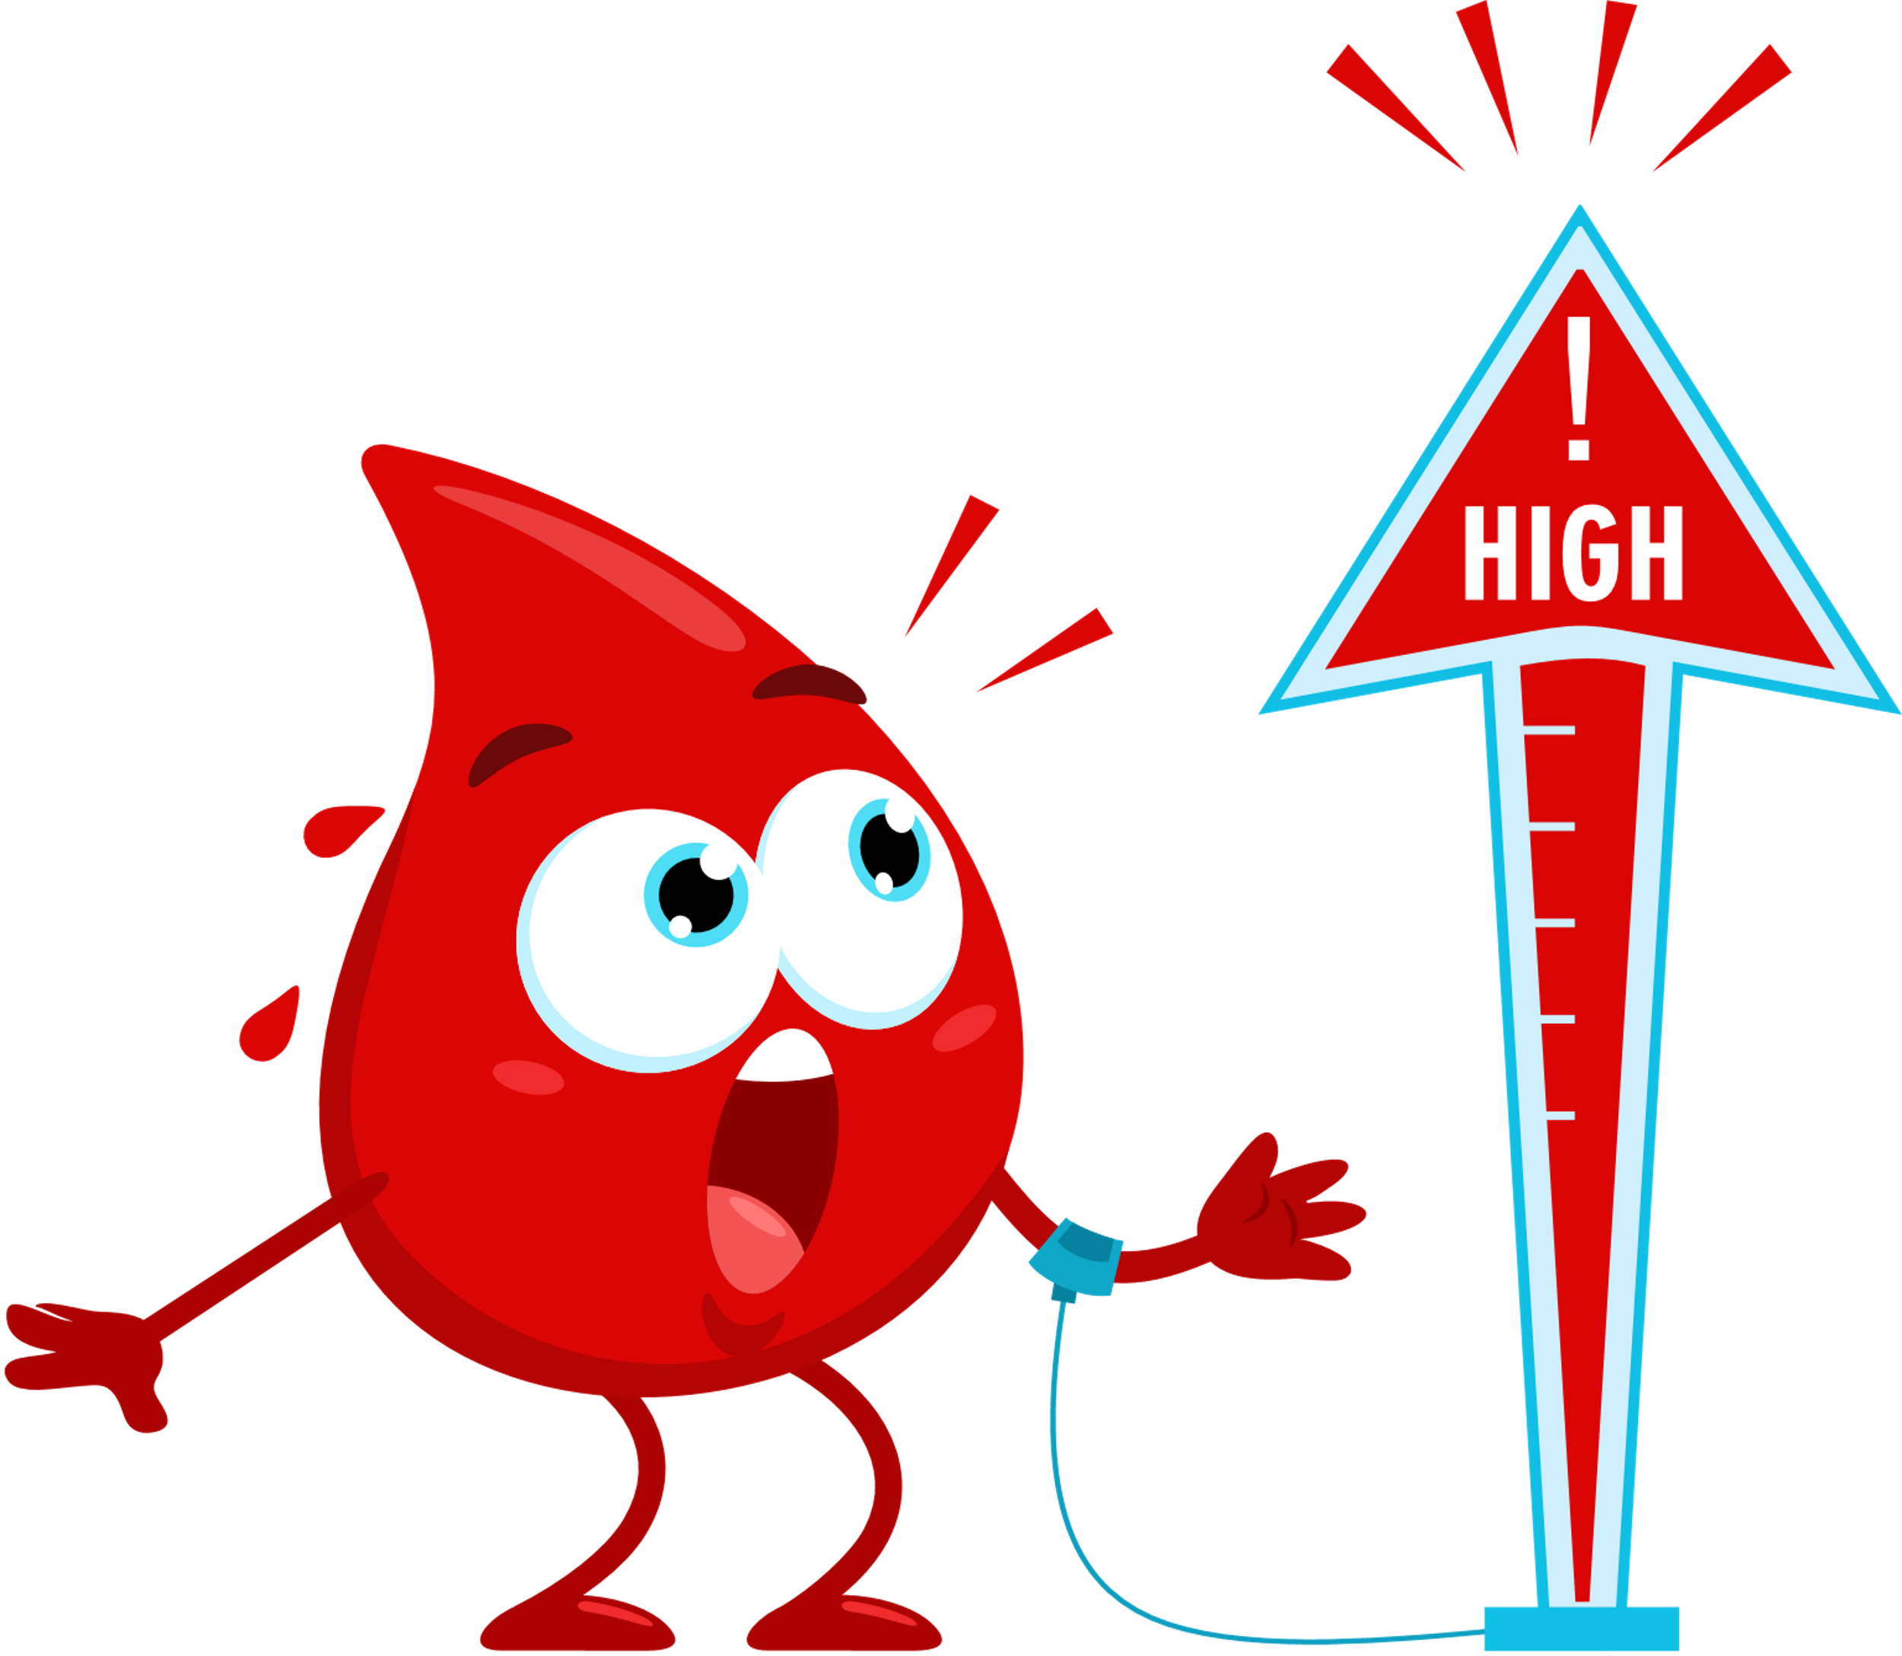
Blood Alcohol Content
110 lb female
.51%
150 lb female
.37%
110 lb male
.44%
150 lb male
.32%
BAC Impairment
Mild .05%
Increased .15%
Severe .30%
Life threat .45%
2 hour
Notes:
Discussion:
These numbers are dangerous.
Too much alcohol can threaten your life.
Additional- n/a
Cue for next slide:
Let’s discuss how this could happen- so we can prevent a life-threatening situation.

Slide 12
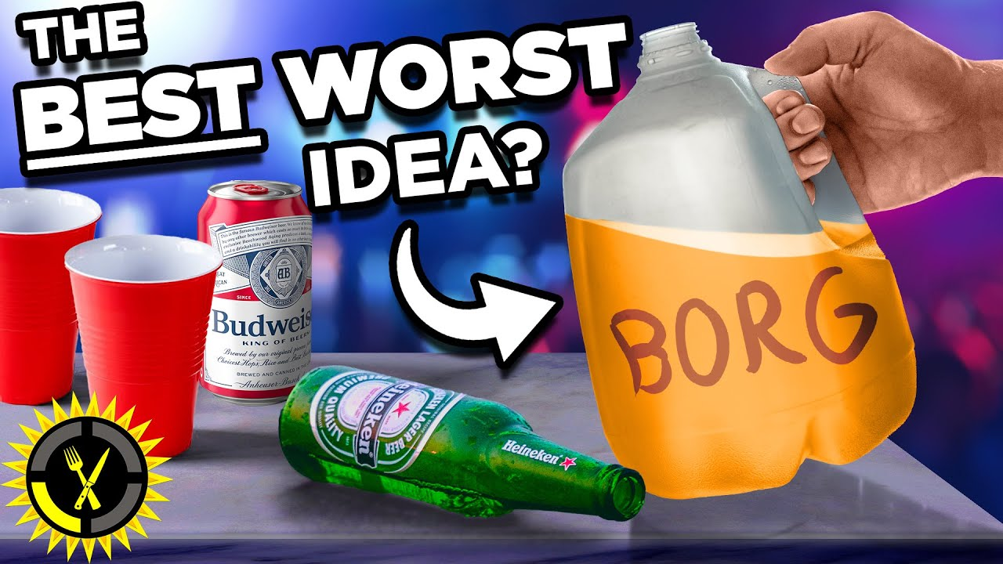
Deadly Trends
BORGS — an acronym for "blackout rage gallons"
Notes:
Discussion:
Have you heard of this- just one example of a deadly trend? (BORG)
What is the atmosphere at parties like? (drinking may be encouraged; there might be challenges or dares)
What other deadly trends do you know of?
What do you think it would be like to tell someone at a party to stop drinking? (likely it would be hard, very hard)
Additional:
Students will likely have heard of others.
Use any other current trends, stories or concerns.
Cue for next slide:
Next is a video about Brett’s story.
This clip is from a newscast, about 6 minutes long
It may be hard to watch.

Slide 13
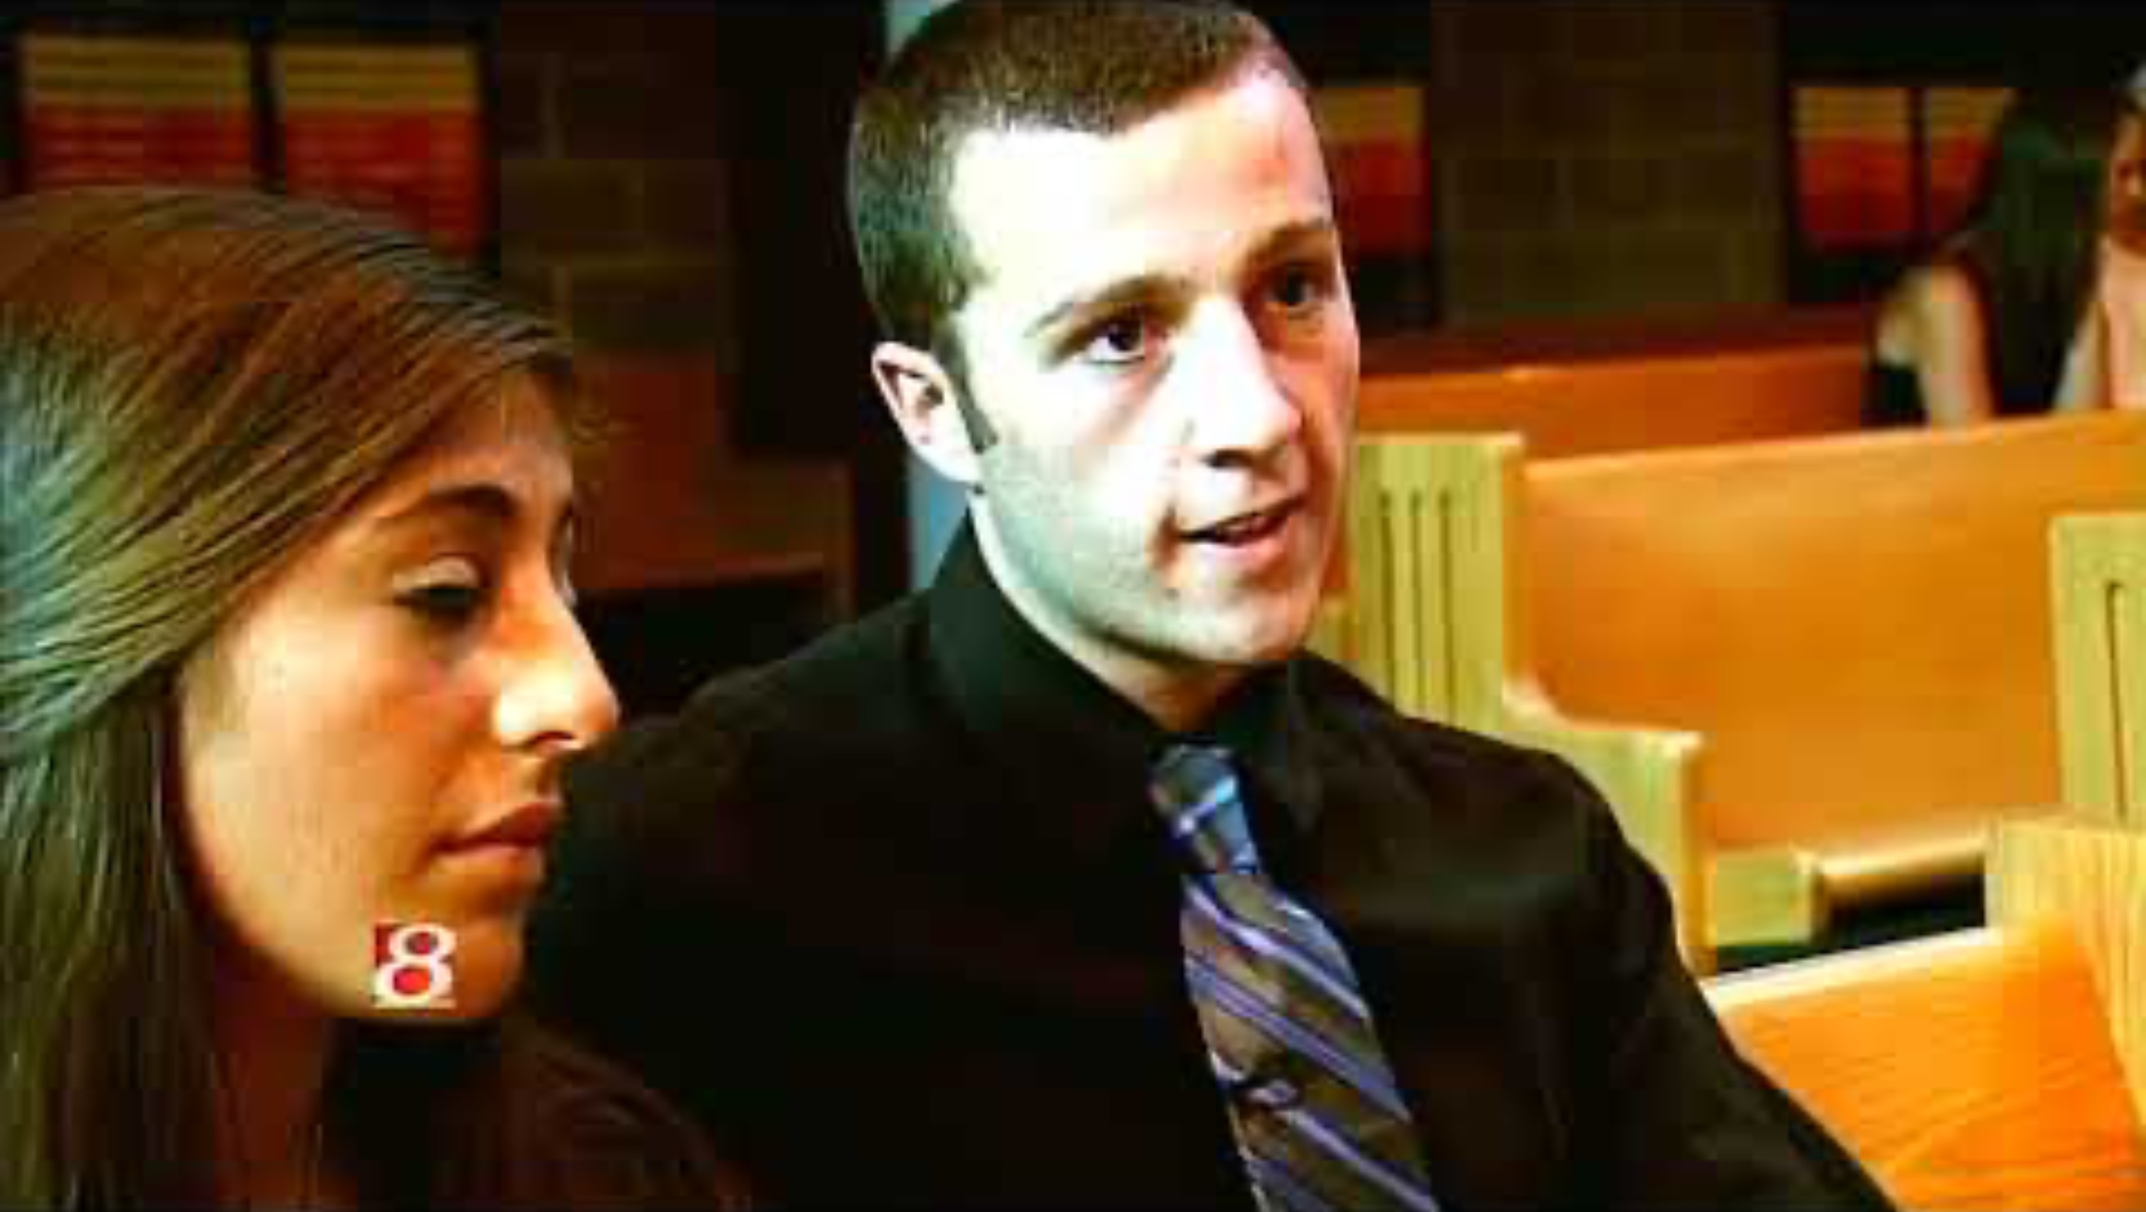
Brett’s Story
Notes:
Brett’s story, News 8
Discussion- as needed
Youtube link:
https://www.youtube.com/watch?v=KXnpJzUEaIs&t=9s
Additional videos on IYSA website:
https://indysb.org/makegooddecisions/videos-resources/

Slide 14
Know the Signs - Call 911
    Acting Unusually Confused
    Repetitively Throwing Up
    Skin Looks Pale or Bluish
    Loss of Bodily Functions
    Snoring Unusually or Loudly
    Passed Out- can't awaken the person
Notes:
Discussion:
We don’t want other kids to die.
You can help by recognizing these signs of alcohol poisoning and getting help.
Go through the list of what to look for.
Additional-n/a
Cue for next slide:
Its also good to know what not to do- that’s on our next slide.

Slide 15
Deadly Mistakes
      Thinking you can play doctor
      Thinking you can wait to call
      Thinking your friend can sleep it off
      Thinking your friend might be mad at you
      Thinking there will be a second chance
Notes:
Discussion:
Go through list of mistakes that can turn into a deadly situation
Even doctors need special equipment to diagnose, don’t think you can tell how bad someone is by looking at them.
Don’t wait to call for help.
BAC continues to rise- don't let them 'sleep it off’
Additional- n/a
Cue for next slide:
Lets recap a few things next.

Slide 16
Stay & Cooperate
Talk to 911 Operator and first responders
Lay the person on their side, the recovery position
Give accurate and truthful information
The Person in need, the Caller, and EVERYONE who Stays and Cooperates gets immunity.
Notes:
Discussion:
Recap what to do- call 911
Be prepared to answer questions about what the person consumed-if you know; type of alcohol and how much.
If you can safely do so, lay the person on their side- the Recovery Position- so any potential vomit will not choke them.
Stay & Cooperate.
Additional:
Have you ever called 911 before?
What kind of questions do they ask? (what is the emergency, your location, any special entrances to watch for, how are you helping the person in trouble, can someone meet the responders when they get there)
Have you ever talked to a police officer before?
What kind of questions do they ask? (name, age, address, phone number, what happened)
Cue for next slide:
Next is a little more information about immunity and talking to law enforcement.

Slide 17
To receive immunity
Demonstrate acting in good faith to do all:
  Full name and other relevant info
  Remaining on scene until law enforcement & EMS arrive
  Cooperating with authorities on scene
SENATE ENROLLED ACT No. 74 (2025)
Notes:
Discussion:
Students may have some concerns around talking to law enforcement.
This is a list of what to how to interact/what to expect.
Stay and cooperate.
Additional:
Officers and EMS will want to know if anything else was consumed as far as prescription medication, illegal drugs, etc. EMS will need to know for treatment options and police officers may be asking if they are first to arrive. Officers may also ask about the student’s experience with alcohol and how often they drink: weekly, monthly, infrequently, first time, etc. for health reasons.
Officers will ask for ID or personal information: name, DOB, address, parents name/telephone number. The information will be used to complete a report and contact parents if they are under 18 yrs old.
If students are unsure about immunity and an officer’s familiarity with the Lifeline Law, when they call for help, they can ask "Does this qualify for the Lifeline Law immunity"? The question is a segway into the officer's knowledge or lack thereof. If the officer is not aware of the law, it is an opportunity for the caller to explain the law and the immunity which it provides. The more details and specifics they know and share the better. The officer will realize the caller knows what he is talking about.
At most Indiana college campuses, the officers are very aware of the Lifeline law. Some officers may take enforcement action if the "patient" is in possession of drugs which are not covered by the Lifeline Law.
https://iga.in.gov/legislative/2025/bills/senate/74/details
Cue for next slide:
Its good to have a plan a be prepared. Next we have a pledge that you can make.

Slide 18
“I will do my BEST to
Make Good Decisions.
If someone needs HELP, I will
make the call.
If I need help, I give you
permission to
make the call for me.”
Notes:
Invite students to:
Stand up and read this together
Make the Pledge!
Additional:
Thank you for making a commitment to help your friends.
Cue for next slide:
Lets talk about any more ideas to be prepared.

Slide 19
Know what you will do before you might be in this situation.
What is your plan?
Notes:
Discussion:
Any ideas that students might offer.
What is your plan to make good decision?
Talk to your friends and trusted adults.
Additional:
Only go to parties that you think will be safe.
Make plans with friends ahead of time about alcohol and protecting each other.
Talk to a parent/adult to get advice about friends who might be drinking.
Have a parent/adult that you can call for help.
Cue for next slide:
Next are a few resources if you want to learn more.

Slide 20
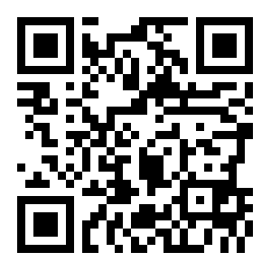
^{Resources}
https://www.makegooddecisions.org/
Substance Abuse and Mental Health Services Administration
^{https://www.samhsa.gov/}
Centers for Disease Control and Prevention
https://www.cdc.gov/alcohol/index.htm
Notes:
Discussion:
Resources for more info
QR code goes to MGD website
Additional- n/a
Cue for next slide:
MGD social media

Slide 21
^{Share your stories or}
^{connect on social media}
Facebook: Make-Good-Decisions
Instagram: @mkgooddecisions
Twitter: @MKGDDECISION
Notes:
Discussion:
If you want to share or see any stories, check out the MGD social media
Additional:
To share a story and request anonymity, send it by email to: mwhelchel@indysb.org
Cue for next slide:
Evaluation form, then optional activity

Slide 22
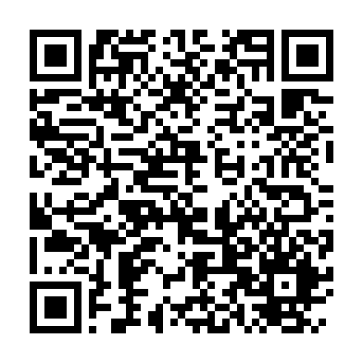
Evaluation form
Help us keep track of how many students got to watch this presentation.
Complete the short evaluation with the QR code.
You will not be asked for your name. Thank you.
Notes:
Use QR code
Or send feedback to:
https://indianayouthservicesassociation.formstack.com/forms/mgd_awareness_presentation

Slide 23
^{Poster Activity}
Create a poster that you would share with friends.
What would you want them to know about the Lifeline Law?
^{Use what you learned today.}
Notes:
Discussion:
Read poster activity.
Share posters in your school.
Or send posters to IYSA: mwhelchel@indysb.org
Additional activities:
Spread awareness on social media
Create more awareness at your school by having a campaign for MGD.
Example: Carmel high school, has had t-shirts, scholarships, and soccer games dedicated to MGD awareness

Slide 24
A STATEWIDE PUBLIC EDUCATION AND
AWARENESS PROGRAM
Notes:
end

Slide 25
This slide left Blank
Notes:
In between long version & short version

Slide 26
A STATEWIDE PUBLIC EDUCATION AND
AWARENESS PROGRAM
Notes:
Dear presenter:
This presentation has been given to you to help educate Indiana youth about the Lifeline Law and dangers of underage drinking.
Notes are provided to help you guide the conversation and an activity.
Any discussion about alcohol is not intended to promote underage drinking, it it intended to educate young adults about the dangers related to alcohol consumption.
Please adjust the slides and discussion to best educate your audience.
For questions, reach out to Michele: mwhelchel@indysb.org

Slide 27
Indian Lifeline Law
The Lifeline Law gives amnesty for underage drinking and many related drinking offenses to a person in need, a person who calls, and bystanders who assist in reporting a medical emergency, crime or sexual assault. The purpose of the law is not to encourage underage drinking, but to protect Hoosiers in emergency situations and hopefully save lives.
It’s simple:
            1) CALL or TEXT 911
            2) STAY
            3) COOPERATE
Notes:
Discussion:
Can someone read this?
What do you think it means?
Do you understand the word ‘amnesty’? (that means you will be protected from prosecution, or being charged with a crime such as underage drinking)
Who is a ”person in need”? (this is a person who is sick, injured, assaulted, had too much to drink, etc.. i.e. the person you would be getting help for if you called 911)
Why is this law important? (this is about harm reduction, to save lives in case kids are afraid they would get in trouble if they call for help)
Do you know who makes this kind of law? (it is from our state law-makers, Senators and Representatives; it started with SB 227 in 2012 and then SB 74 was added in 2025)
Is this something you can remember; call, stay, cooperate?
Why is it important to Stay & Cooperate? What does that mean? (this is required for amnesty; you will need to talk to first responders and police who come to help; stay calm and answer questions )
Did you know that you can text 911 for help? (voice is preferred, but texting is ok if that’s what you need to do. Indiana was one for the first states to have texting to 911- cool!)
Additional info:
The Indiana Lifeline Law was first established with the help of Senator Jim Merritt in 2012.
It did not originally include amnesty for the person in need (i.e. the person who was had too much to drink), but this was corrected in 2025 with SB 74 which added amnesty for the person in need.
Some other states have similar laws, but it is not nationwide. Each state has specific guidelines. This is good to know if/when you go to college or are visiting outside of Indiana.
Some students may see the limitations. It protects them from “many related drinking offenses” but not from all crimes; yes this might seem a little unclear. Underage drinking is usually the biggest worry for those thinking about calling. Students may not have amnesty from other consequences such as getting in trouble with a sports team, club, or other school related expectations. This is where we can reiterate that we are not saying it is ok to drink underage; but we are letting them know that a friend could die if they do not seek help and they will not be charged with the crime of underage drinking.
This presentation will focus on alcohol consumption. But the law also applies to getting help if there was a crime or sexual assault.
https://www.911.gov/newsletters/issue-9/national-annual-report-reveals-ng911-text-to-911-progress/#:~:text=Thirty%2Dthree%20states%20reported%20having,states%20in%20the%20calendar%20year
http://indianalifeline.org/
Cue for next slide:
Next let’s talk about knowing when to call for help.

Slide 28
Know the Signs - Call 911
    Acting Unusually Confused
    Repetitively Throwing Up
    Skin Looks Pale or Bluish
    Loss of Bodily Functions
    Snoring Unusually or Loudly
    Passed Out- can't awaken the person
Notes:
Discussion:
We don’t want other kids to die.
You can help by recognizing these signs of alcohol poisoning and getting help.
Go through the list of what to look for
Additional-n/a
Cue for next slide:
Its also good to know what not to do- that’s on our next slide.

Slide 29
Deadly Mistakes
      Thinking you can play doctor
      Thinking you can wait to call
      Thinking your friend can sleep it off
      Thinking your friend might be mad at you
      Thinking there will be a second chance
Notes:
Discussion:
Go through list of mistakes that can turn into a deadly situation
Even doctors need special equipment to diagnose, don’t think you can tell how bad someone is by looking at them.
Don’t wait to call for help.
BAC continues to rise- don't let them 'sleep it off’
Additional- n/a
Cue for next slide:
Lets recap a few things next.

Slide 30
Stay & Cooperate
Talk to 911 Operator and first responders
Lay the person on their side, the recovery position
Give accurate and truthful information
The Person in need, the Caller, and EVERYONE who Stays and Cooperates gets immunity.
Notes:
Discussion:
Recap what to do- call 911
Be prepared to answer questions about what the person consumed-if you know; type of alcohol and how much.
If you can safely do so, lay the person on their side- the Recovery Position- so any potential vomit will not choke them.
Stay & Cooperate.
Additional:
Have you ever called 911 before?
What kind of questions do they ask? (what is the emergency, your location, any special entrances to watch for, how are you helping the person in trouble, can someone meet the responders when they get there)
Have you ever talked to a police officer before?
What kind of questions do they ask? (name, age, address, phone number, what happened)
Cue for next slide:
Next are a few ideas about being prepared.

Slide 31
Know what you will do before you might be in this situation.
What is your plan?
Notes:
Discussion:
Any ideas that students might offer.
What is your plan to make good decision?
Talk to your friends and trusted adults.
Learn more about how alcohol affects our bodies- it can be sneaky!
Additional:
Only go to parties that you think will be safe.
Make plans with friends ahead of time about alcohol and protecting each other.
Talk to a parent/adult to get advice about friends who might be drinking.
Have a parent/adult that you can call for help.
Cue for next slide:
QR code for evaluation form

Slide 32
Evaluation form
Help us keep track of how many students got to watch this presentation.
Complete the short evaluation with the QR code.
You will not be asked for your name. Thank you.
Notes:
QR code asks for:
School or name of organization presenting
Or send feedback to:
https://indianayouthservicesassociation.formstack.com/forms/mgd_awareness_presentation

Slide 33
A STATEWIDE PUBLIC EDUCATION AND
AWARENESS PROGRAM
Notes:
end

